Slide 1

PPT Presentation

Slide 2

HTML

Slide 3
Introduction to HTML
HTML (Hypertext Markup Language) is a standard markup language used to create web pages. It provides a means to describe the structure and layout of a document, including headings, paragraphs, images, and links. HTML is used in conjunction with other technologies such as CSS and JavaScript to create dynamic and interactive web pages.

Slide 4
The Purpose of HTML
The primary purpose of HTML is to provide a way to create structured, well-formed documents that can be displayed in web browsers. HTML allows developers to create headings, paragraphs, lists, images, links, and other types of content that can be rendered by a browser to create a webpage.
HTML also enables creating forms. Additionally, HTML can be used to create interactive elements and dynamic content with the help of JavaScript.

Slide 5
How does HTML work?
HTML works by using a set of predefined tags, which are enclosed in angle brackets (< >).
For example, a <p> tag indicates that the text inside the tag should be displayed as a paragraph, while an <img> tag tells the browser to display an image. A <a> tag indicates a link to another webpage, and the browser will display the linked text as a hyperlink.

Slide 6
Basic HTML Document Structure:
<!DOCTYPE html>
<html>
<head>
<title>My Webpage</title>
</head>
<body>
<h1>Welcome to my webpage</h1>
<p>This is a simple webpage created using HTML.</p>
</body>
</html>

Slide 7
Out put:
Welcome to my webpage
This is a simple webpage created using HTML.

Slide 8
Image
The <img> element is used to embed images in an HTML document. The <img> element is an empty element, which means that it has no closing tag and it requires the use of attributes to define the source and other properties of the image.
Example:
<img src="image.jpg" alt="A beautiful landscape">

Slide 9
Example
<img src="pic_trulli.jpg" alt="Italian Trulli">
Example
<img src="img_girl.jpg" alt="Girl in a jacket">
Example
<img src="img_chania.jpg" alt="Flowers in Chania">

Slide 10
HTML Images Syntax
The HTML <img> tag is used to embed an image in a web page.
Images are not technically inserted into a web page; images are linked to web pages. The <img> tag creates a holding space for the referenced image.
The <img> tag is empty, it contains attributes only, and does not have a closing tag.
The <img> tag has two required attributes:
src - Specifies the path to the image
alt - Specifies an alternate text for the image

Slide 11
Advantages of Image
Images are an easy way to improve the user experience of your website. 90 percent of all information that we perceive and that gets transmitted to our brains is visual. Images can help you to attract attention and to guide your visitor's line of sight.

Slide 12
Disadvantages of Image
Some disadvantages of hot linking worth considering are that the webpage usually loads slower when you link to images stored on a different web hosting .

Slide 13
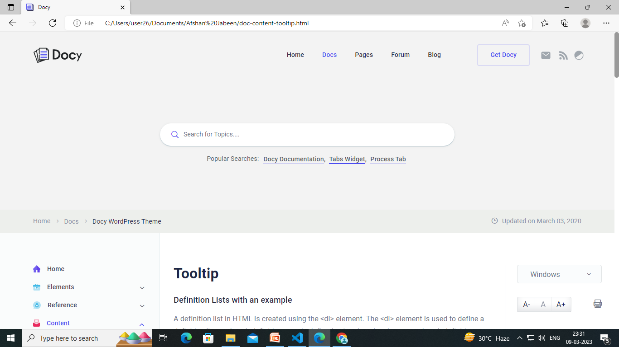


Slide 14



Slide 15
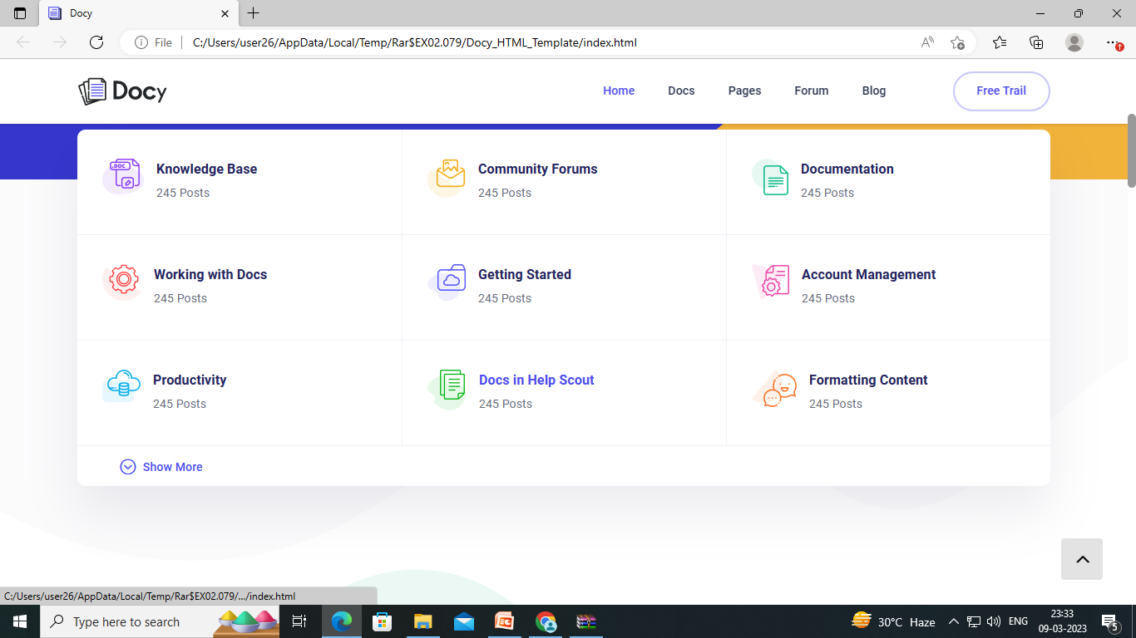
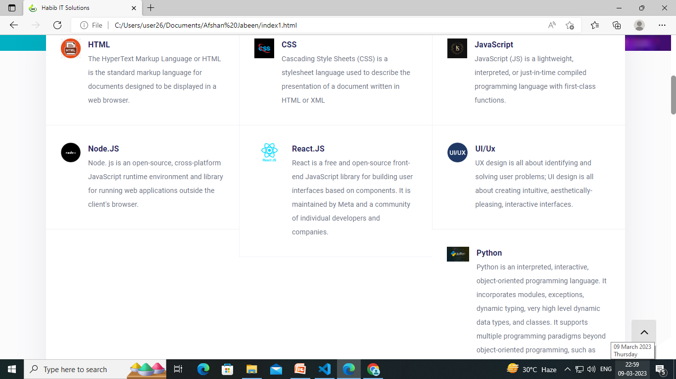

Slide 16
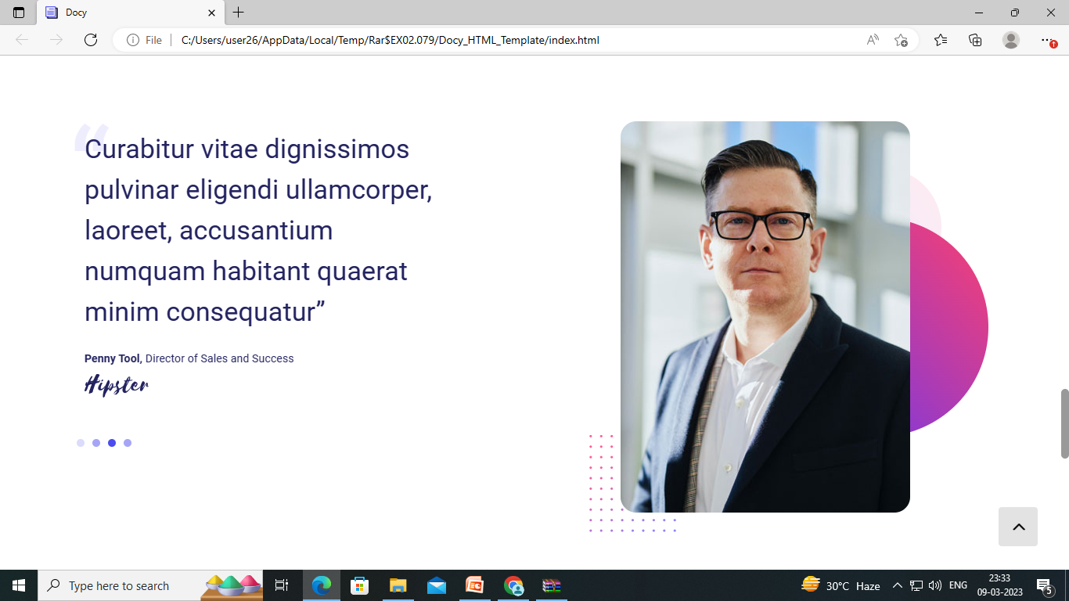

Slide 17


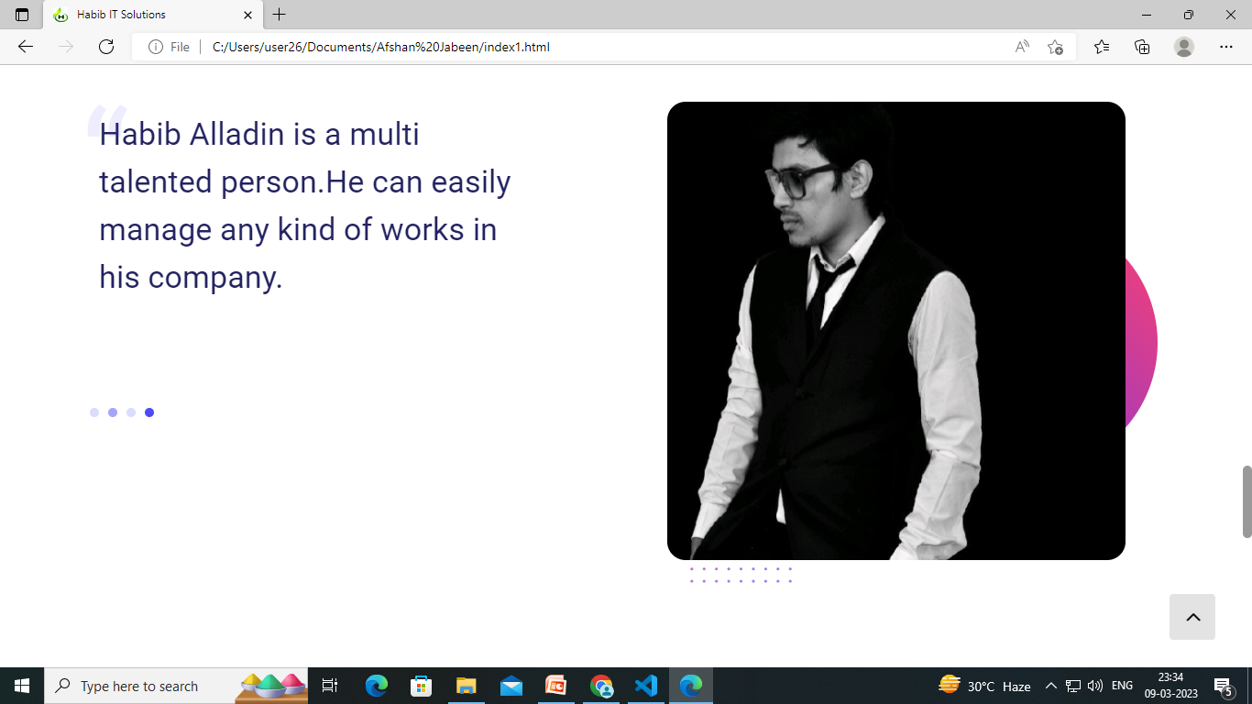
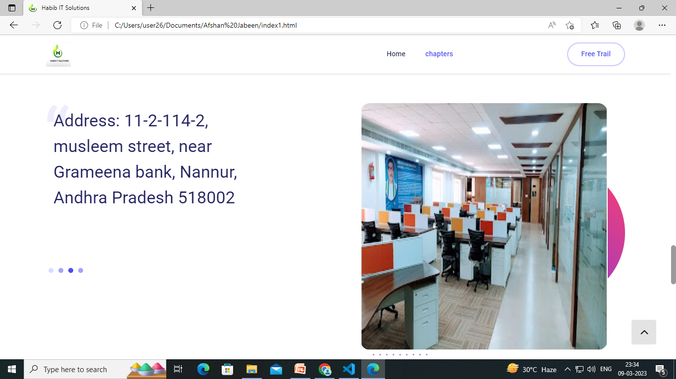

Slide 18
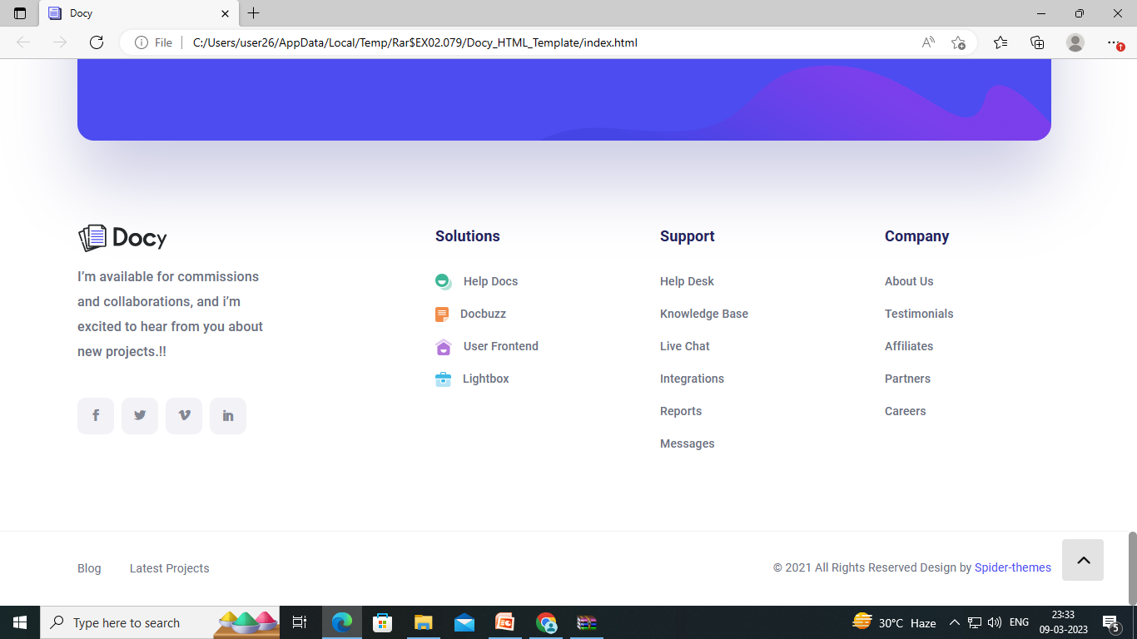
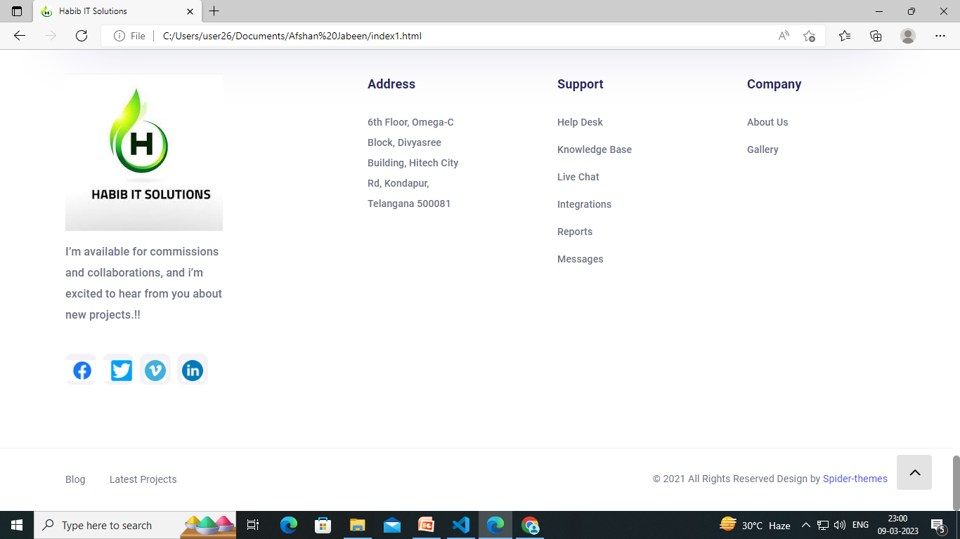

Slide 19
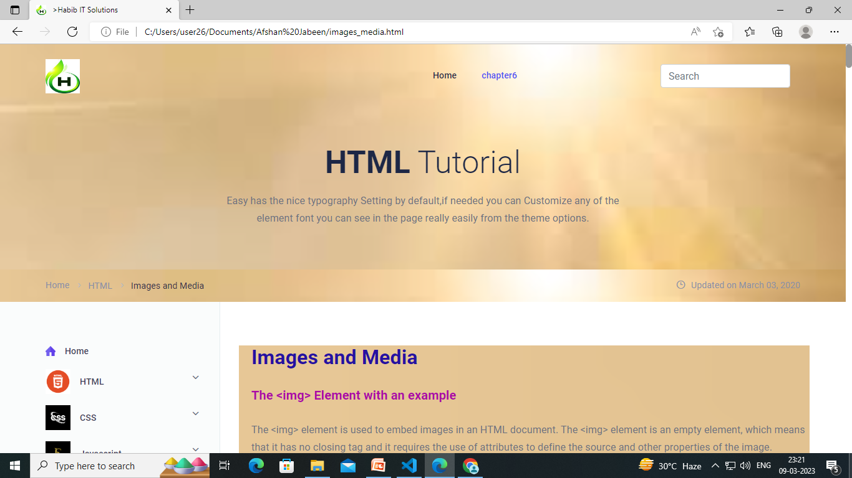
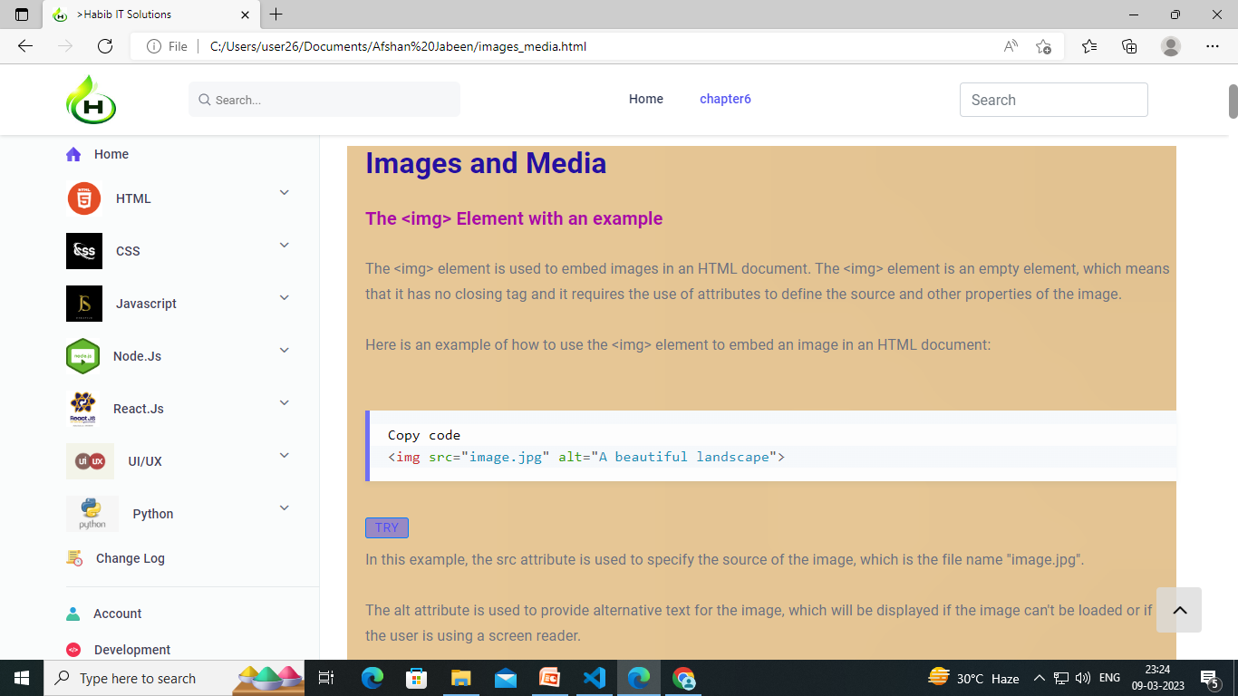

Slide 20
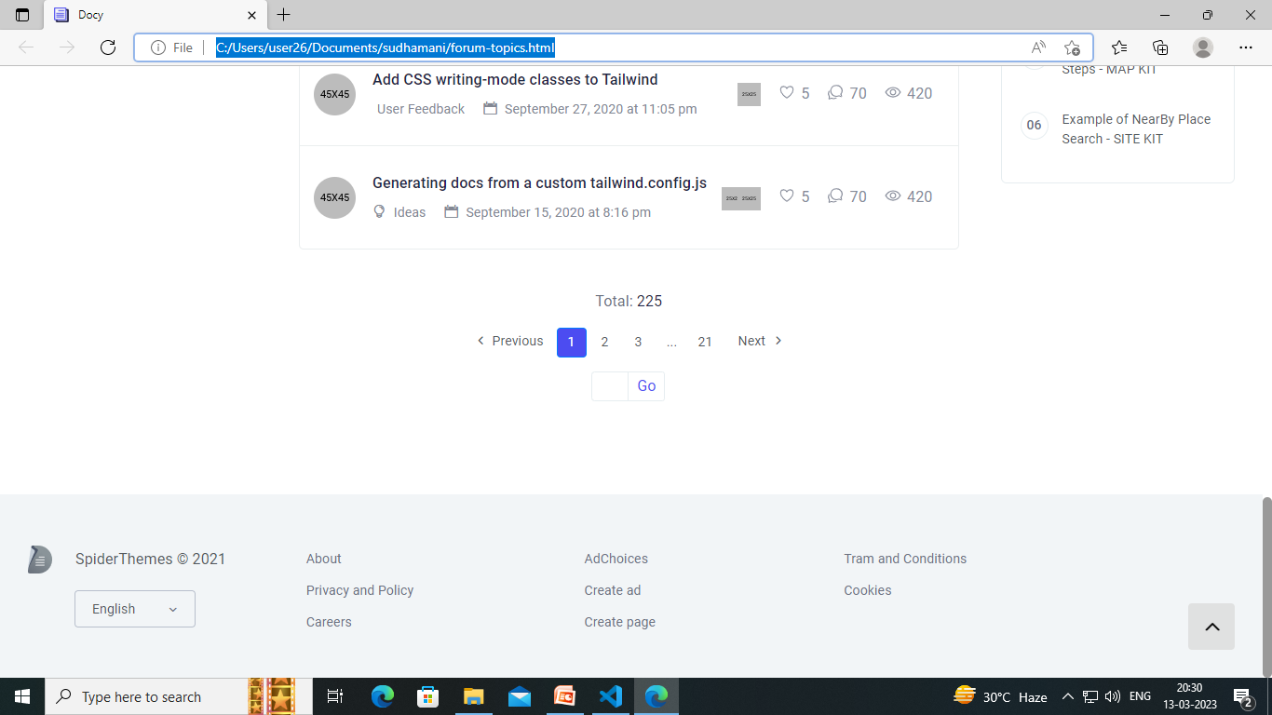
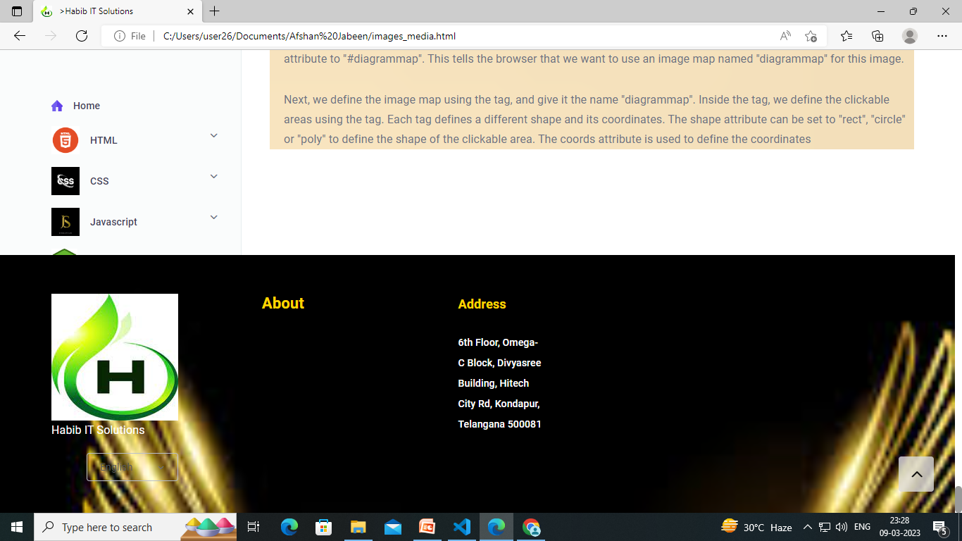

Slide 21


Slide 22


